Slide 1

Strategic Map
Balanced Score Card
Created by
- Rivan Ardyanto Sutoyo M. Rizky Bangga -
- Siti Rodliyah Purnama Sari Yusep Tedja Purnama -

Slide 2

About Adidas Group
Adidas is the largest sportswear manufacturer in Germany and Europe and the second biggest sportswear manufacturer in the world.
A German multinational corporation that designs and manufactures sports clothing and accessories.
Founded: August 18, 1949 by Adolf "Adi" Dassler
Headquarters: Bavaria, Germany

Slide 3

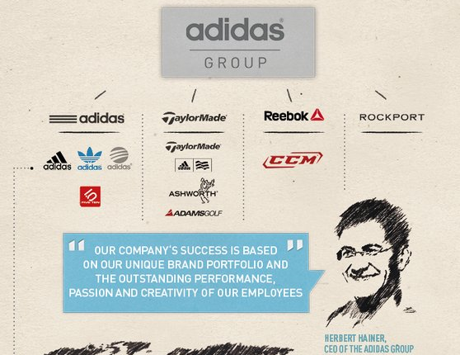



Company background
About Adidas Group

Slide 4
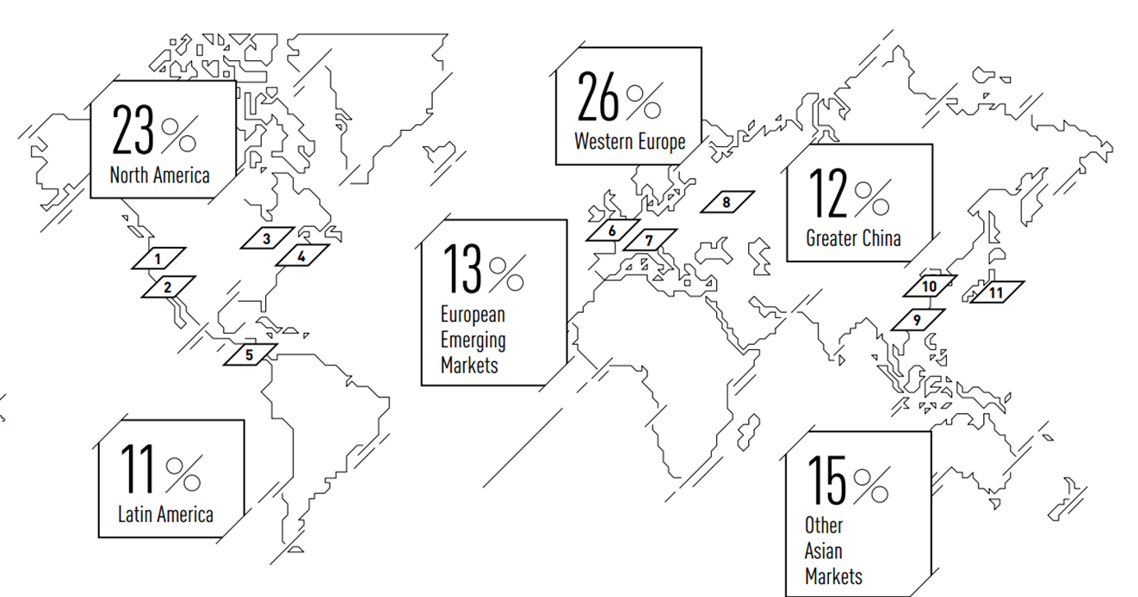
Company background
Overall Brand and Sub-brands
% of Group Sales

Slide 5
ADIDAS
MISSION
The adidas Group strives to be the global leader in the sporting goods industry with brands built on a passion for sports and a sporting lifestyle. We are committed to continuously strengthening our brands and products to improve our competitive position.
VISION
The company is innovation and design leaders who seek to help athletes of all skill levels achieve peak performance with every product we bring to market.
The company are consumer focused and therefore we continuously improve the quality, look, feel, and image of our products and our organizational structures to match and exceed consumer expectations and to provide them with the highest value.
The company are a global organization that is socially and environmentally responsible, that embraces creativity and diversity, and is financially rewarding for our employees and shareholders.
The company are dedicated to consistently delivering outstanding financial results.

Slide 6
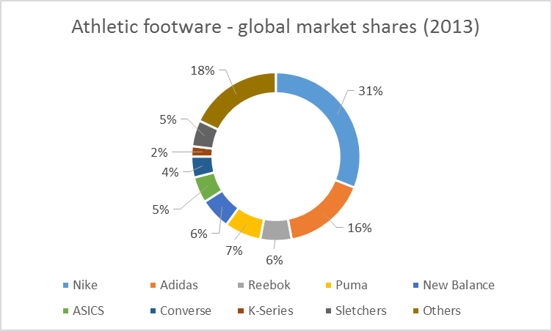
External Analysis
COMPETITORS ANALYSIS
1st
2nd
3rd
4th
5th
Credit http://ridgewoodavenuejournal.blogspot.com/2013/06/footwear.html

Slide 7
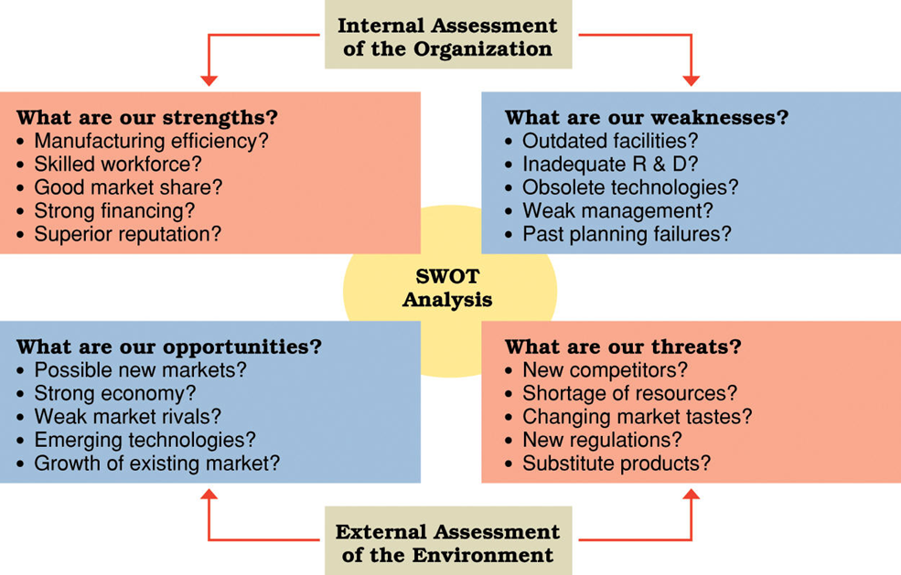

STRENGTH
Financial strength
Effective marketing strategy, distribution mix, diverse brand portfolio and Supply Chain Management and Innovations
Brand Value
The company has worldwide presence and is internationally recognized.
WEAKNESS
High dependency of raw material prices
Low margin
Poor share price in U.S. Market
Customers have high brand switching
OPPORTUNITIES
Investments focused on highest potential markets and channels
Technological innovations
Tie-up with emerging sports teams/clubs/players internationally
Brand building by setting up sports academies
THREATHS
Price fluctuation in raw materials
Unstable currencies exchange
Other brands offer more styles and varieties
Pirated/fake imitations affect brand imagec

Slide 8

Strategies
Adidas Core Competencies
– Technology
– Customer focus
– Brand recognition
– Supply chain
– Collaboratively competitive
Creating shareholder value
Investments focused on highest-potential markets and channels
Creating a flexible supply chain
Leading through innovation
Develop a team grounded in company heritage
Becoming a sustainable company
Brand’s Broad and Unique Product Portfolio
Brand Extension Strategies

Slide 9
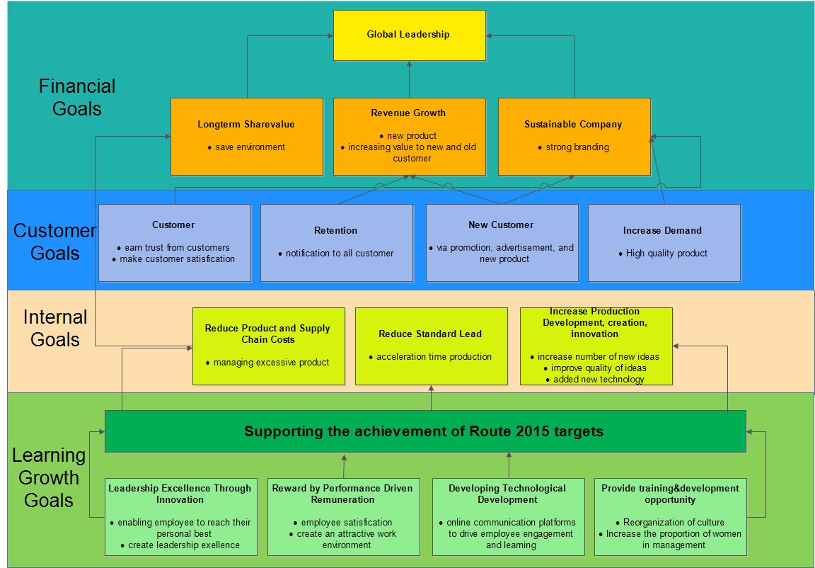
S
T
R
A
T
E
G
I
E
S
M
A
P

Slide 10

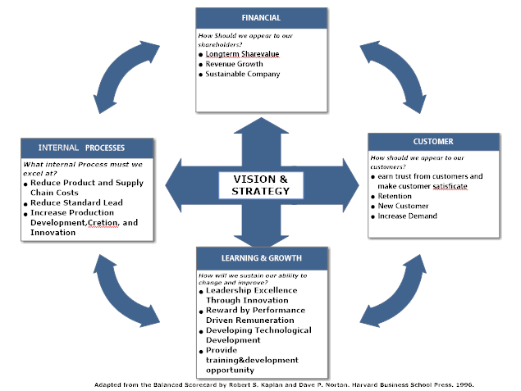
BSC
Balance Scorecard

Slide 11
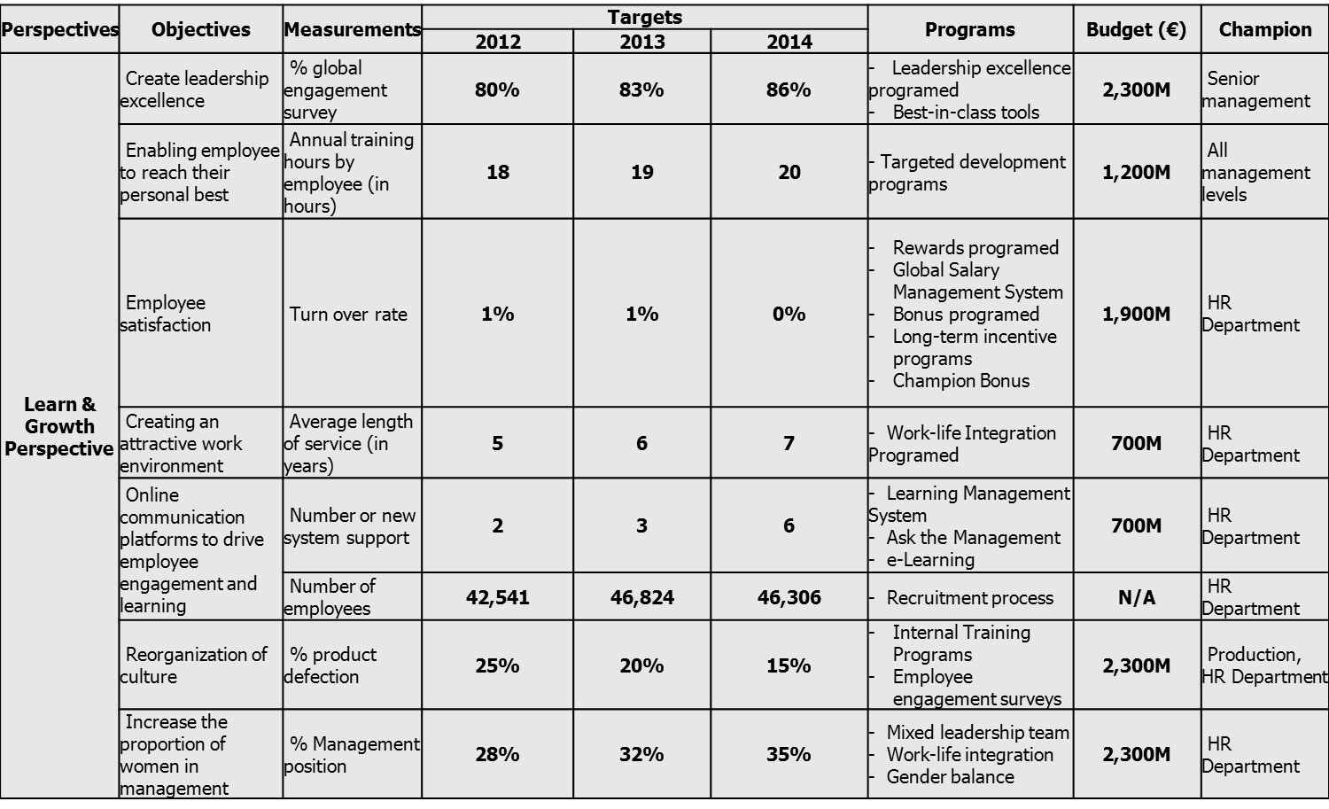
Balance Scorecard
Learning and Growth Perspective

Slide 12
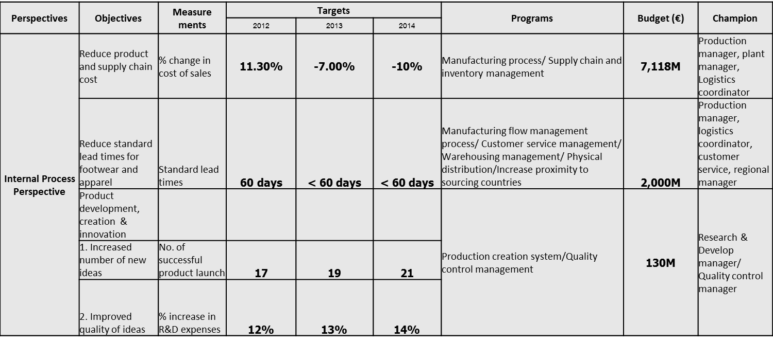
Balance Scorecard
Internal Process Perspective

Slide 13
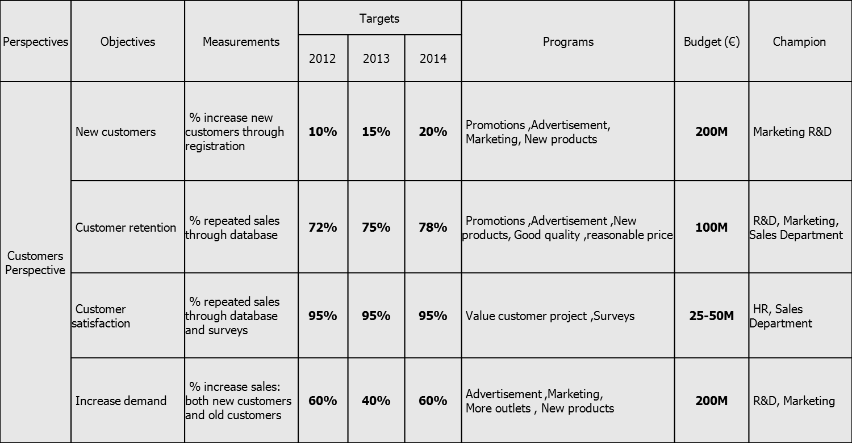
Balance Scorecard
Customer Perspective

Slide 14
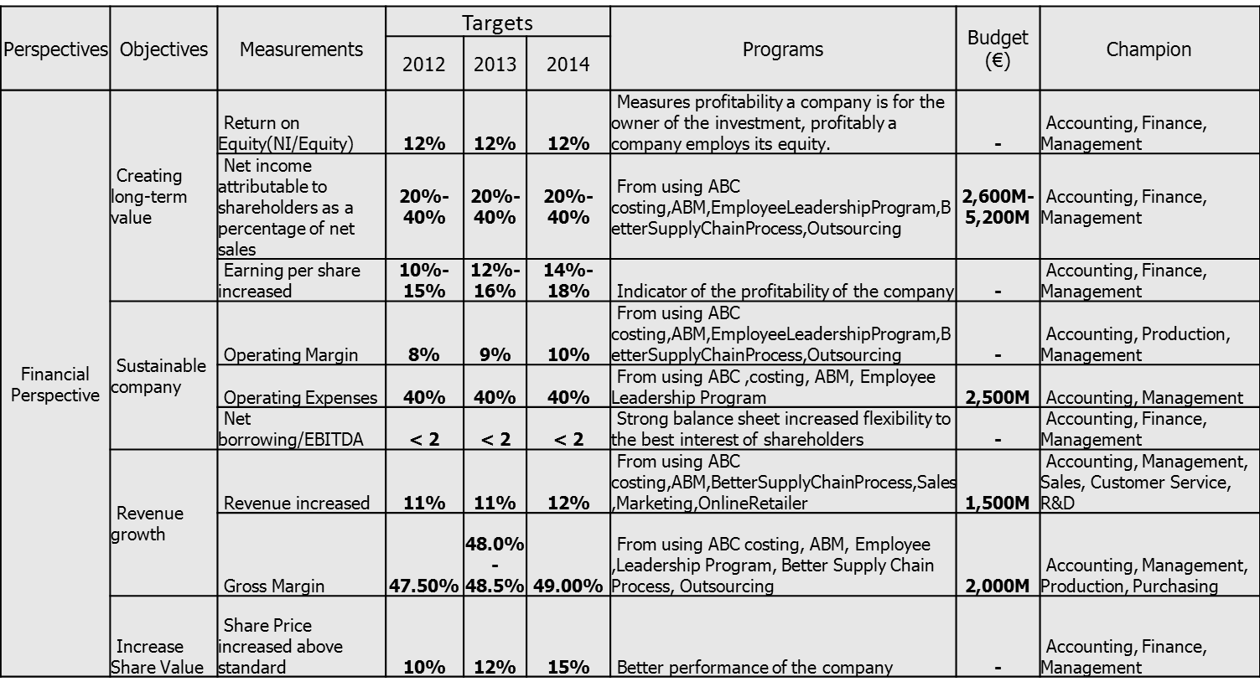
Balance Scorecard
Financial Perspective

Slide 15


