Slide 1
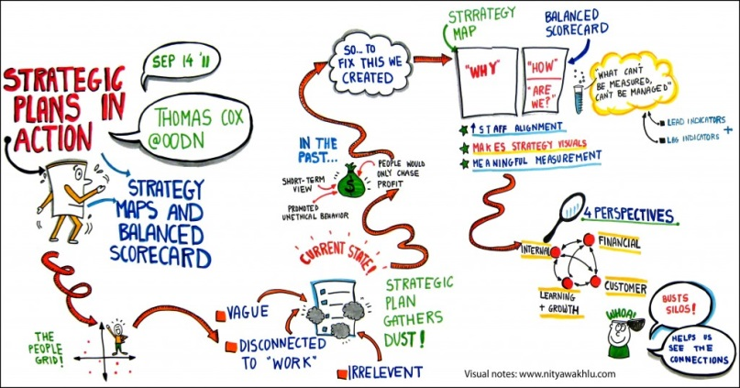
Kelompok 1
Airbus S.A.S.
(Société par Actions Simplifiée)
Name
Bandy Cipta Nur Ramadhan
Dhanne Siswanty Putri Ginting
Ria Arumsari
Rizky Ananda

Slide 2
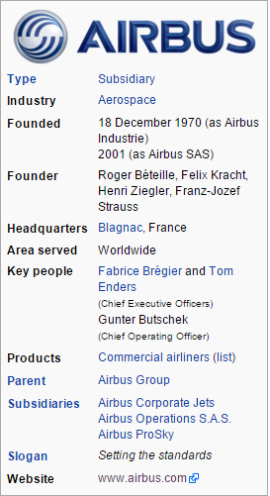
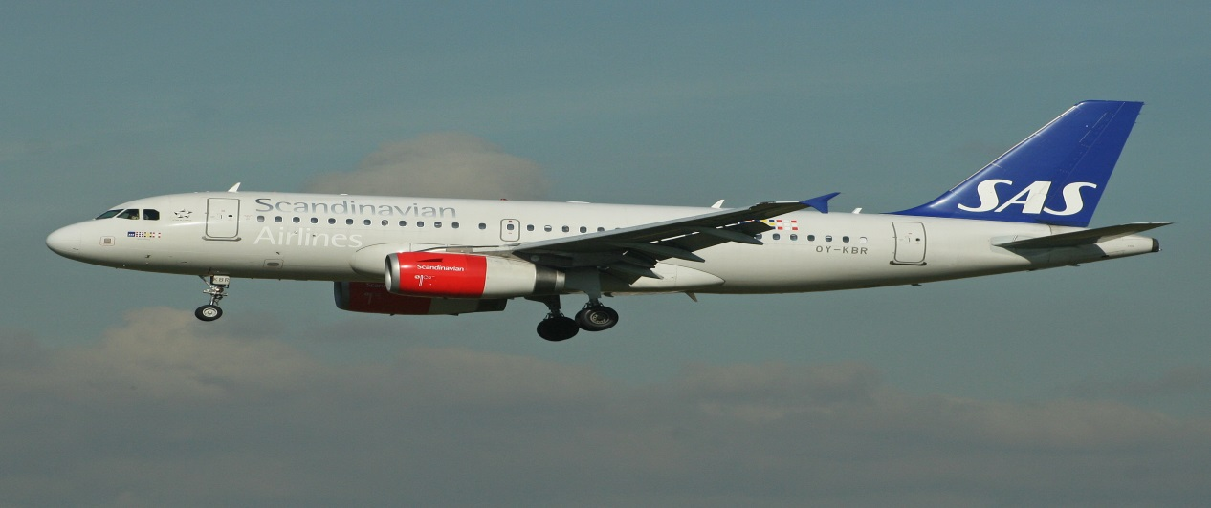
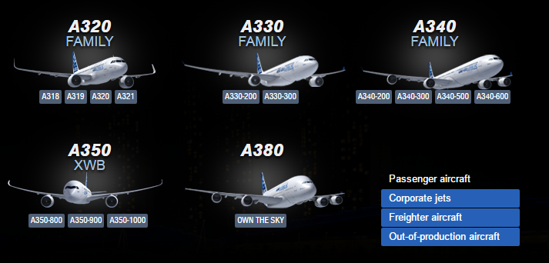
Company Background
About Airbus S.A.S

Slide 3
Airbus Worldwide Presence
Airbus of North America
Airbus China
Toulouse
Airbus Japan
subsidiaries
History of Airbus
Place : Toulouse, France
Employees : 63.000
Shareholders :
* EADS (80%)
* BAE Systems (20%)
Training Centers
Toulouse (France)
Miami, Florida (USA)
Hamburg (Germany)
Beijing (PRC)
Main Subsidaries
Airbus North America
Airbus China
Airbus Japan

Slide 4
Mission, Vision & Values
Mission : create the best and safest aircraft
Airbus' mission is to meet the needs of airlines and operators by producing the most modern and comprehensive aircraft family on the market, complemented by the highest standard of product support.
Vision : forward thinking aircraft maker
Values
Airbus fosters values of excellence and innovation among its culturally- diverse employees and considers its customers, contractors and suppliers to be partners working in the interests of safety, quality and performance.
Source: http://www.airbus.com/en/corporate/ethics/mission_values/

Slide 5
Airbus Results
Aircraft orders = 62% ^ Value of orders = 78% ^
Year | 1998 | 1999 | 2000 | 2001 | 2002 | 2003 | 2004 | 2005 | 2006 | 2007
Aircraft orders | 556 | 476 | 520 | 375 | 300 | 284 | 370 | 1111 | 824 | 1458
Value of orders (US$ billion) | 39 | 30.5 | 41.3 | 44.7 | 24.3 | 24.3 | 34.4 | 95.9 | 75.1 | 181.1
Cumulative orders | 3203 | 3633 | 4125 | 4399 | 4632 | 4886 | 5252 | 6307 | 7097 | 8555
Aircraft deliveries | 229 | 294 | 311 | 325 | 303 | 305 | 320 | 378 | 434 | 453
Turnover (billion) | US$ 13.3 | US$ 16.7 | US$ 17.2 | Euro 20.5 | Euro 19.5 | Euro 19.3 | Euro 20.2 | Euro 22.2 | Euro 26.0 | N/A
Cumulative deliveries | 1894 | 2188 | 2499 | 2824 | 3127 | 3432 | 3752 | 4130 | 4564 | 5017
Order backlog | 1309 | 1445 | 1626 | 1575 | 1505 | 1454 | 1500 | 2177 | 2533 | 3538
Number of customers | 160 | 169 | 173 | 180 | 191 | 186 | 204 | 225 | 271 | 287
Number of operators | 158 | 178 | 188 | 188 | 188 | 210 | 232 | 249 | 250 | 286
Source: http://www.airbus.com/en/presscentre/

Slide 6
Airbus Business Structure
Source: www.ec.europa.eu/enterprise/ict/conferences/doc/panel-4-slides_mathieu.ppt

Slide 7
Airbus SWOT Analysis
Source: www.ec.europa.eu/enterprise/ict/conferences/doc/panel-4-slides_mathieu.ppt

Slide 8
Airbus Cost Structure
Source: EADS

Slide 9
Supply
Airbus announced it would axe more than 80% of its supply base.
It would reduces the company’s supplier rolls from the current 3000 to just 500, to reduce material costs by ₤1 billion (US$1.9 billion; S$2.8 billion) over the next three years.
Supplier consolidation will also cut administrative costs by an additional ₤235 million (US$446.5 million; S$665.3 million)
Innovation
Align strategic vision and innovation goals with implementation of throughout the organization, focusing on collaboration both vertically and horizontally.
Managing boundaries enables collaboration across organizations, establishing structures and processes regarding governance, operations and technology.
BUSINESS STRATEGY
Customer
Establish stable relationships with all customers, from the biggest to the smallest, from major airlines to regional airlines and start-ups
Support Strategy
Rather than becoming a standalone business unit, building an integrated customer support can help make Airbus airplanes more attractive.
To create a network of MRO (maintenance, repair, and overhaul) providers - Airbus "e- solutions" for maintenance.

Slide 10
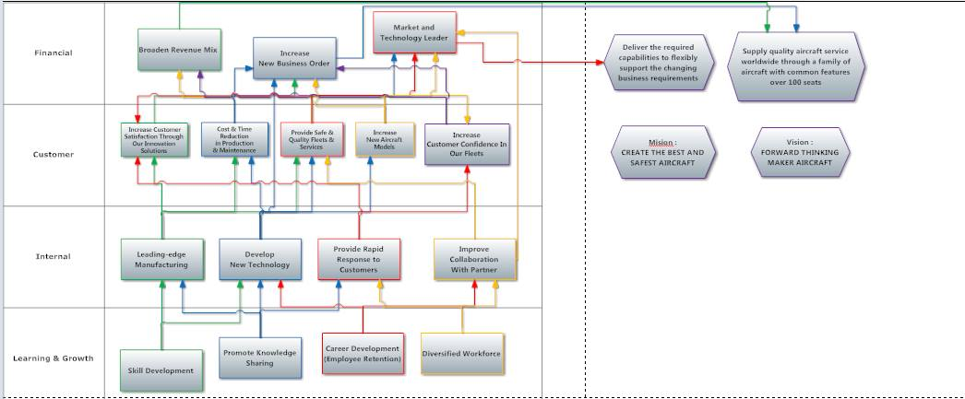
Strategy Map

Slide 11
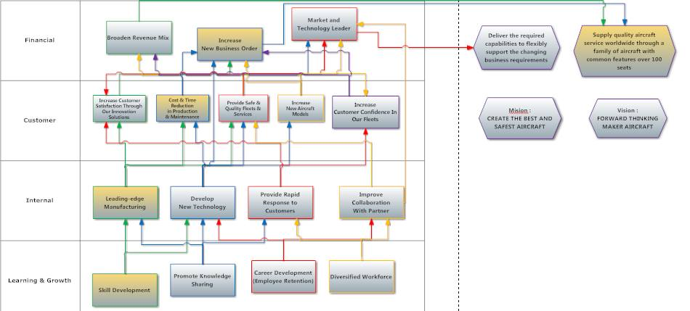
Strategy Map (cont.)

Slide 12
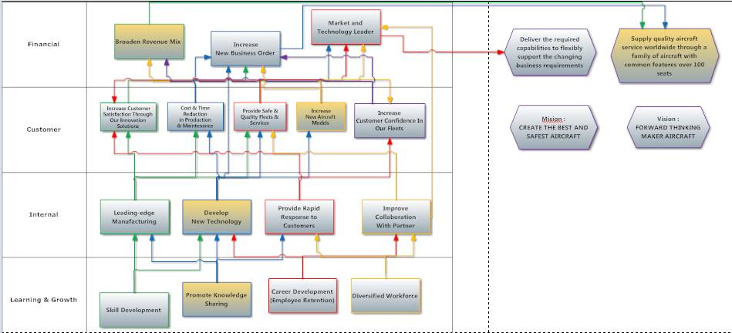
Strategy Map (cont.)

Slide 13
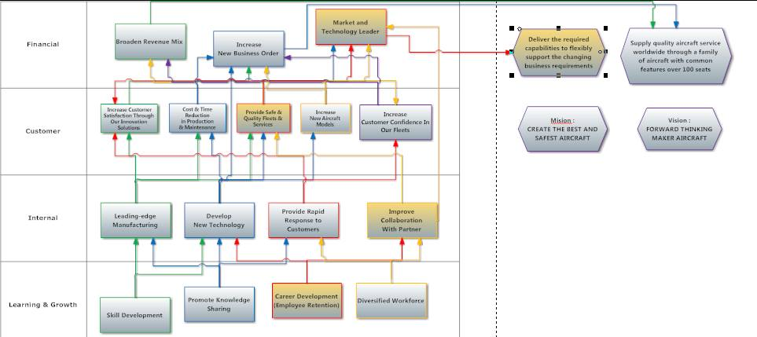
Strategy Map (cont.)

Slide 14
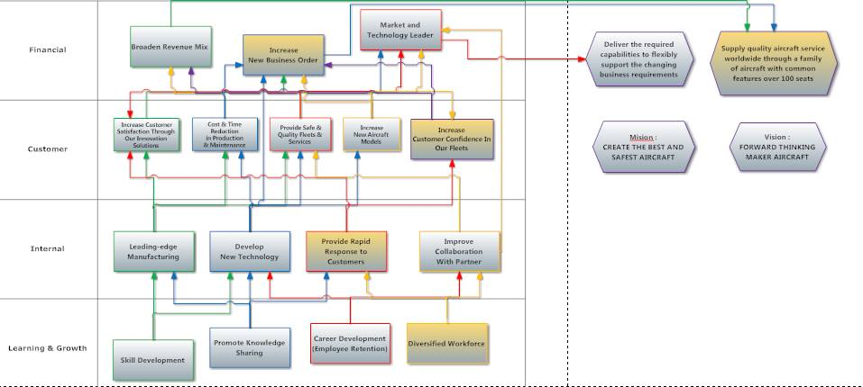
Strategy Map (cont.)

Slide 15
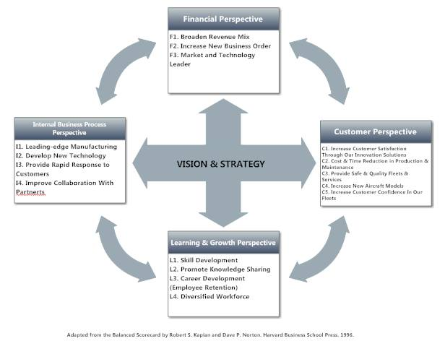
Balanced Scorecard

Slide 16
BSC - THE LEARNING AND GROWTH PERSPECTIVE
STRATEGIC
GOAL
M_{M}E_{E}A_{A}S_{S}U_{U}R_{R}E_{E}
T_{T}A_{A}R_{R}G_{G}E_{E}T_{T} K_{K}P_{P}I_{I}
I_{I}N_{N}I_{I}T_{T}I_{I}A_{A}T_{T}I_{I}V_{V}E_{E}S_{S}
❖Develop, train, retrain current and new employees. Attract, develop and retain knowledge workers (Skill Development)
❖No of Master and PhD qualifications
❖Achieve 20% from recruitment exercises
❖Hire Key Technical Employee.
❖No of training hours per annual
❖Attain at least 48hrs of training per employee/year
❖Improve employee work conditions.
❖Employee skills assessment
❖Percent of employee awards related to quality
❖Employee satisfaction/organization climate surveys
❖Cross training of core knowledge and technical skills
❖Provide excellent and extensive training courses for employees
❖50% increase in number of awards related to quality by FY08
❖Provide language training and promote intercultural awareness
❖Achieve more than 80% by FY08
❖Conduct regular reviews plus personal development planning with employees
Diversified Workforce
❖No of intercultural activities conducted
❖Achieve at least 1 activity per month
❖No. of woman graduate recruits.
❖At least 20% of total recruits
❖Celebrate and reward individual and team performance
❖Tie incentives to quality
❖Provide mentoring to new employees
❖Form CoPs
❖Career development
❖Staff attrition rate
❖Not more than 20% in FY08
❖No. of employees promotion
❖5% increase for capable employees
❖Promote Knowledge Sharing
❖No of ideas created and codified/published
❖At least 2 new ideas from each employee

Slide 17
BSC - THE INTERNAL BUSINESS PROCESS PERSPECTIVE
STRATEGIC GOAL
M_{M}E_{E}A_{A}S_{S}U_{U}R_{R}E_{E}
T_{T}A_{A}R_{R}G_{G}E_{E}T_{T} K_{K}P_{P}I_{I}
I_{I}N_{N}I_{I}T_{T}I_{I}A_{A}T_{T}I_{I}V_{V}E_{E}S_{S}
Develop new technology
No of patents and innovations invented
❖Increase 30% by FY08
❖Collaboration with institutions and universities
No of innovations adopted
❖Leveraging Information Systems and Experts for knowledge creation and reuse
❖10% improvement from FY07
❖Provide rapid response to customers
❖Technical dispatch reliability rate
❖Increase employees collaboration around the world
❖Achieve more than 99% operating reliability for all fleets
❖Improvement in manufacturing processes
❖Leading-edge manufacturing
❖Time to market
❖Reduce cycle time by 30%
❖Effective supply chain management
❖No of defective products from suppliers
❖<10% defective rate per suppliers
❖Supplier Rating
❖<10% of supplier rejection
❖Production rate per aircraft model per month
❖XX A320 XX A340 XX A380
❖Improve collaboration with partners
No of collaborations with partners
❖Participate in at least 10 new initiatives in FY08

Slide 18
BSC - THE CUSTOMER PERSPECTIVE
STRATEGIC GOAL
M_{M}E_{E}A_{A}S_{S}U_{U}R_{R}E_{E}
T_{T}A_{A}R_{R}G_{G}E_{E}T_{T} K_{K}P_{P}I_{I}
I_{I}N_{N}I_{I}T_{T}I_{I}A_{A}T_{T}I_{I}V_{V}E_{E}S_{S}
Increase customer confidence
❖Maintenance downtime
❖Require less than 1hr per model
❖Provide innovative solutions to customers
❖Increase customer satisfaction
❖Customer Satisfaction Rating
❖Improve customer rating by 10% by FY08
❖Improvement in manufacturing processes
❖Customer retention rate
❖Increase no of repeated customer orders by 10% per year
❖Conduct Customer Satisfaction Surveys, Email and Mail Surveys
❖Provide excellent after sales service
Cost & Time Reduction in Production & Maintenance
❖Training cost for ground crews, pilots, etc(Airbus Cross Crew Qualification (CCQ))
❖Less than 2wks of training for pilot conversion and crew maintenance
❖Implement design commonality in all fleets
❖Ensure compliant to EASA and FAA requirements
Provide Safe & Quality fleets & Services
❖No of test flight hours conducted
❖10% more than regulatory requirement
❖Effective supply chain management
❖No of on-time delivery
❖99% on target
❖Compliance to ISO14001 standards
❖Zero NCN per audit
❖Reduce accident rate
❖Reduce accident rate by 10%
Increase new aircraft models
Total no of choices available for customers
10% increment in amount of choices available

Slide 19
BSC - THE FINANCIAL PERSPECTIVE
STRATEGIC GOAL
M_{M}E_{E}A_{A}S_{S}U_{U}R_{R}E_{E}
T_{T}A_{A}R_{R}G_{G}E_{E}T_{T} K_{K}P_{P}I_{I}
I_{I}N_{N}I_{I}T_{T}I_{I}A_{A}T_{T}I_{I}V_{V}E_{E}S_{S}
❖Broaden Revenue Mix
❖% of order from various fleet models
❖XX% A320 XX% A3XX XX% A380
❖Participate in air shows globally
❖Tell/Publish success stories on various medias
❖Increase new business orders
❖No of gross orders
❖Achieve 20% more in total gross order by FY08
❖No of backlog orders
❖Provide innovative solutions to customers
❖No of new customer orders vs fleet models
❖Achieve 10% more in total backlog order by FY08
❖Introduce new aircraft model
❖Achieve 10% order from new customers per models
❖Provide financial solutions to leasing companies, corporate, budget and full service airlines and air-cargo companies
❖Market and Technology leader
❖% market share
❖> 50% market share
❖No of innovation products and services
❖2 or more major products/services/yr
❖Total no of aircrafts delivery
❖Achieve 15% increase for FY08
❖% of reduction in CO₂
❖10% reduction in FY08

