Slide 1
The Second Anniversary
Concept and Program Design

Slide 2
Strategic Context of Second Anniversary
Strategic Challenges :
Lack of collaboration
Lack of contribution in National society and industries
2014
2018
2015
Second Anniversary
Issue and Strategic:
Increasing Brand Image, commitment
Become WCU
National Contribution
Collaboration
Present Strategic Issues:

Slide 3
Theme of Second Anniversary :
Menguatkan Inovasi Kolaboratif
(Meningkatkan Keterlibatan Seluruh Stakeholders) berinovasi untuk Berkontribusi
Bagi Masyarakat dan Industri Nasional
Strenghtening Collaborative Innovation for Community & National Industry

Slide 5
Goals of Second Anniversary:
Increasing stakeholders involvement in achieving Tel U goal
Increasing eksternal/National contribution for accelerating toward World Class University
Developing collaboration and management excellent in developing National programs

Slide 6
Second Anniversary Programs :
Involvement
Student Olympiad
Management Excellent
Internal Workshop on “Two Years Reflection of Telkom University”
National Contribution
Community Service Program
Seminar and ICT Award
HR Competition and award
dll
SMU and SMK program and award
ICT Expo
International Conferences

Slide 7
Target of Participants (Segmented by Program):
1. Civitas Academica (Olah 4R intrnl: Dosen, TPA )
2. Student prospect (lomba siswa SMA, SMK, award sekolah)
3. Industries (Expo: ICT, Telcos, Telco Subcons, asosiasi)
5. Government (award on ICT, ....., )

Slide 8
PRELIMINARY EVENT SERIES
NO | EVENTS | SCHEDULE | VENUE
1. | Kick Off 2nd Anniversary | 18 Feb 15 | Situ techno
2. | International Conferences | Mar-Agustus
3. | Industrial Gathering | Mart | Landmark Braga
4. | Lomba Or Kes Pegawai | Mar -Sept | BTPlex
5. | Lomba Or Kes Mahasiswa | Mar -Sept | BTPlex
6. | Lomba Akademik Mahasiswa | Mar -Sept | BTPlex
7. | Lomba SMU dan SMK | Mar -Sept | BTPlex
8. | Abdimas PANSELA | Mar-Sept | Pansela
9. | Tel-U ICT & Creative Award | Apr - Sept | TUCH
10. | Bakti Sosial | 14 Agst15 | Ling BTPlex
11. | Two Years Reflection | 2 Sept | MM C
12 | Open Senat Session | 14 Agus | TUCH

Slide 9
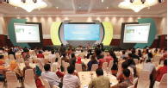
INTERNATIONAL CONFERENCE EVENT SERIES
NO | CONFERENCES | SCHEDULE | VENUE | OWENERS
1 | ISIEM | 17 – 19 Mar | Malang | FRI
2 | TRUSTY ICON | 9-10 Jul | Haris, Bdg | FIT
3 | GTAR | 20 – 21 Apr | Trans Lux | FKB
4 | ICoICT | 27 – 29 May | Denpasar | FIF
5 | ISCLO | Jul | On planning | FEB
6 | AP Media Cast | 23 – 25 Apr | Denpasar | FTE
7 | Bandung Creative Movement | 8 – 10 Sep | BTPlex | FIK
8 | APW IMOB + IC CEREC | 27 -29 | Trans Lux | FTE
9 | SCBTII | Sept |  | FEB

Slide 10
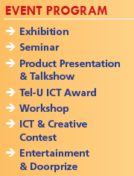
TOP EVENTS

Slide 11
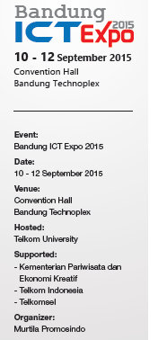
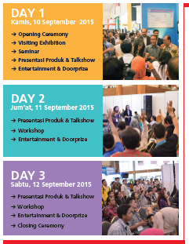
TOP EVENTS
TOP EVENT

Slide 12
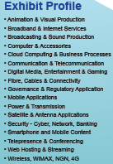
Visitors Profile
Exhibit Profile
Banking & Finance
Broadcasters & Producers
Carriers & Facilitators
Channel Distributors
Consultancy, R & D
Content & Software Developers
Government & Regulatory
Helath & Medicare Providers
Investment & Insurance
ISP & Access Providers
Lecture & Entertainment
Media & Publisher
Program Designers & Developers
Resellers & Vendors
Software & Solutions Providers
System Integrators
Telco & Network Operators
Training & Educations
Travel & Transport Operators

Slide 13
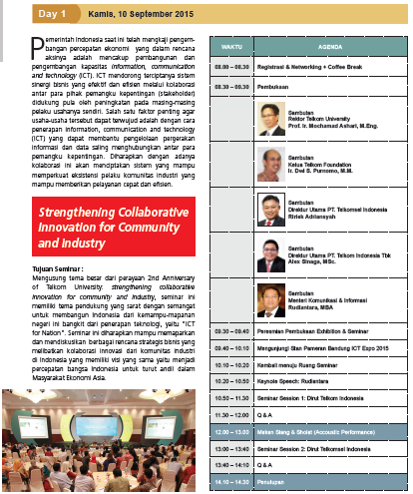
TOP EVENTS

Slide 14
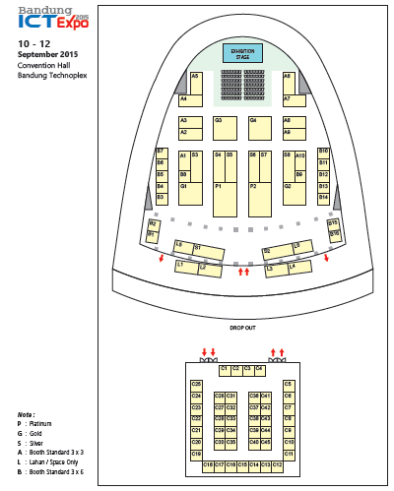
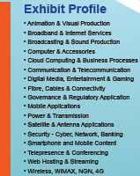
TOP EVENTS

Slide 15
Semoga Allah swt memberkati rencana kita

